Slide 1
Virtue of Generosity
Generosity is the virtue of giving and not taking. Generosity is giving to another person without expecting anything in return.

Slide 2
A GENEROUS PERSON….
Cares - wants to make a difference
Has no expectations - doesn’t want anything in return
Is optimistic – always sees the good
Is humble--does not do it to impress others
Has purpose-understands life is more than just about them
Is energetic-doesn’t waste time or energy, is not lazy
Is a leader-they see a need and act; they inspire others to do good too

Slide 3
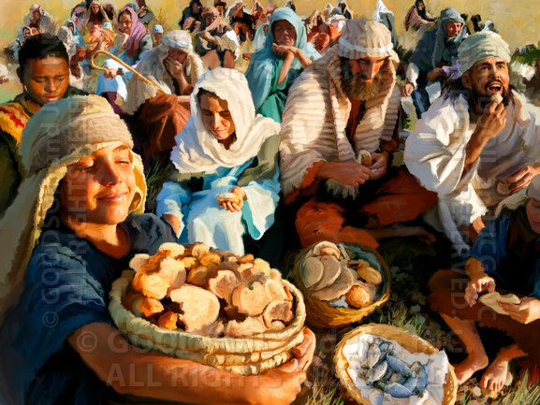
The Miracle of the Loaves and Fish
#Hyperdoc Template created by Kelly Hilton. Adapted by Sr. Ignacia Carrillo, FMA

Slide 4
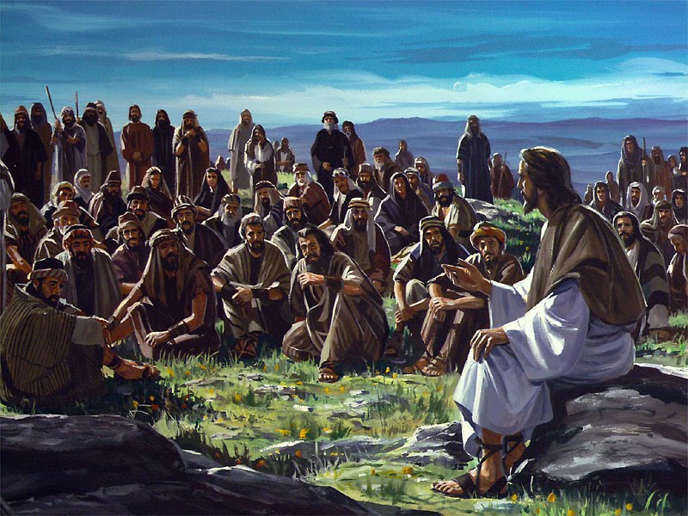
Mark 8: 1-10
When Jesus saw how eager the crowds were to hear Him, taking pity on them, He taught them and healed the sick. Toward evening, some of the apostles asked Jesus to send the crowd away for it was near their suppertime.

Slide 5
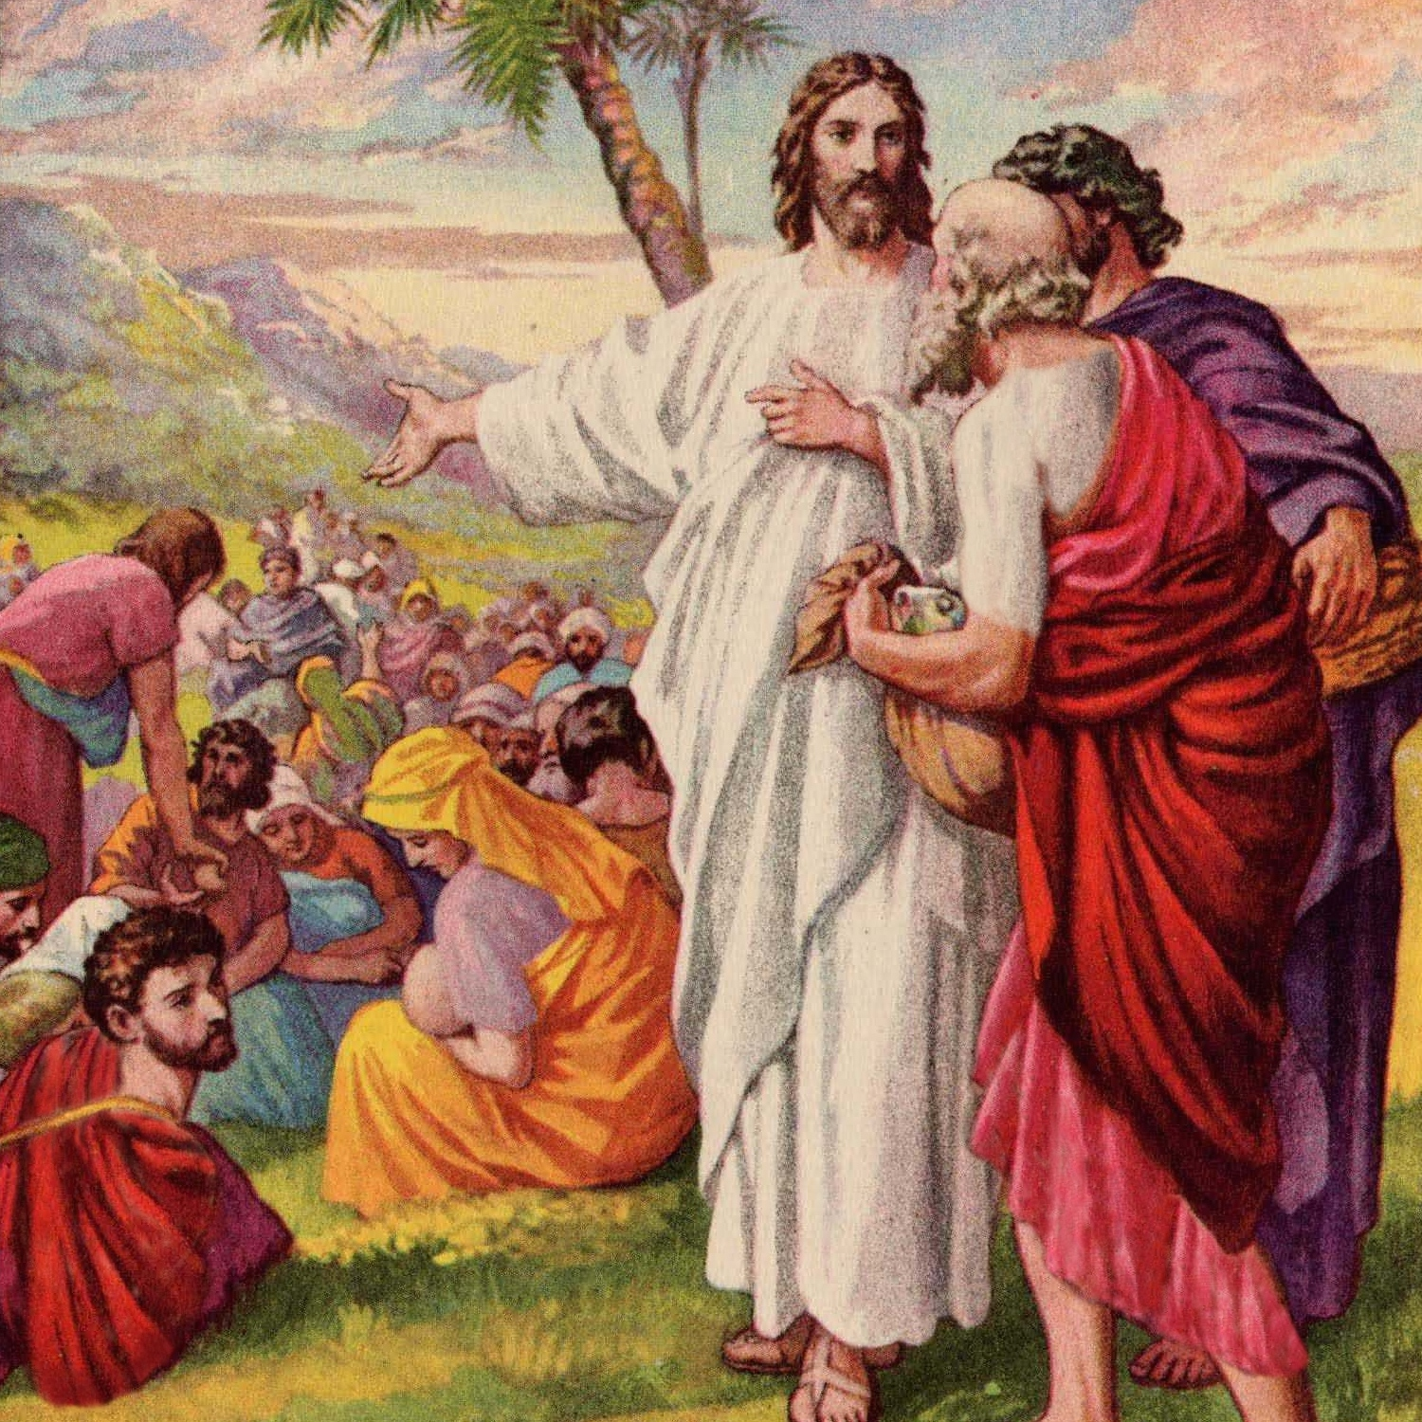
But Jesus said to them, “They need not go away. You can give them food to eat.” Phillip looked at the great crowd, over five thousand men, besides women and children, and he said,”thirty dollars worth of bread would not be enough to give everyone even a little piece.”

Slide 6
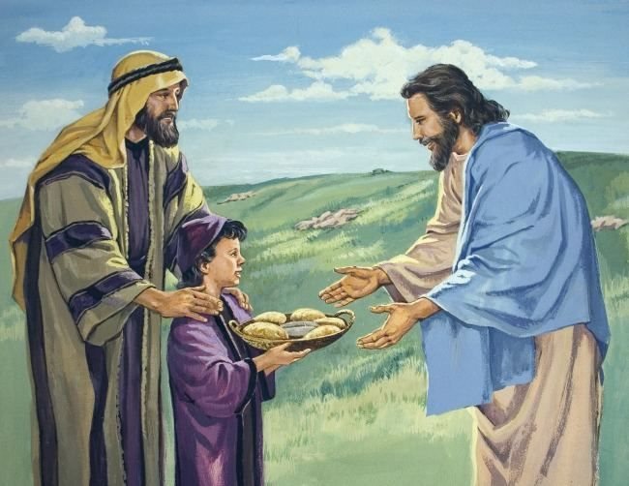
Then another of the apostles, Andrew, Peter’s brother, said to Jesus,”There is a boy here who has five loaves of barley and two dried fishes. But what use would they be among so many people?” Jesus said to the apostles, “ Go out among the people and divide them into groups of fifty and a hundred, and tell them to sit down.”

Slide 7
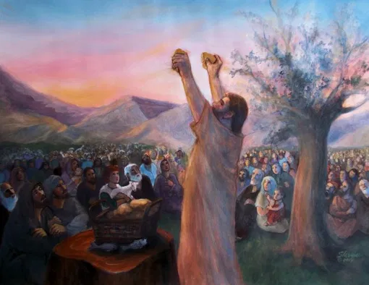
So the people all sat down upon the green grass, and they watched Jesus as He took into His hands the five loaves and the two fish which the boy had brought. He looked up to heaven to thank His Father and blessed the food. He then broke the loaves and the dried fish and gave the pieces to the apostles. They went among the people and gave to everyone bread and fish, as much as each needed. So they all ate and had enough.

Slide 8
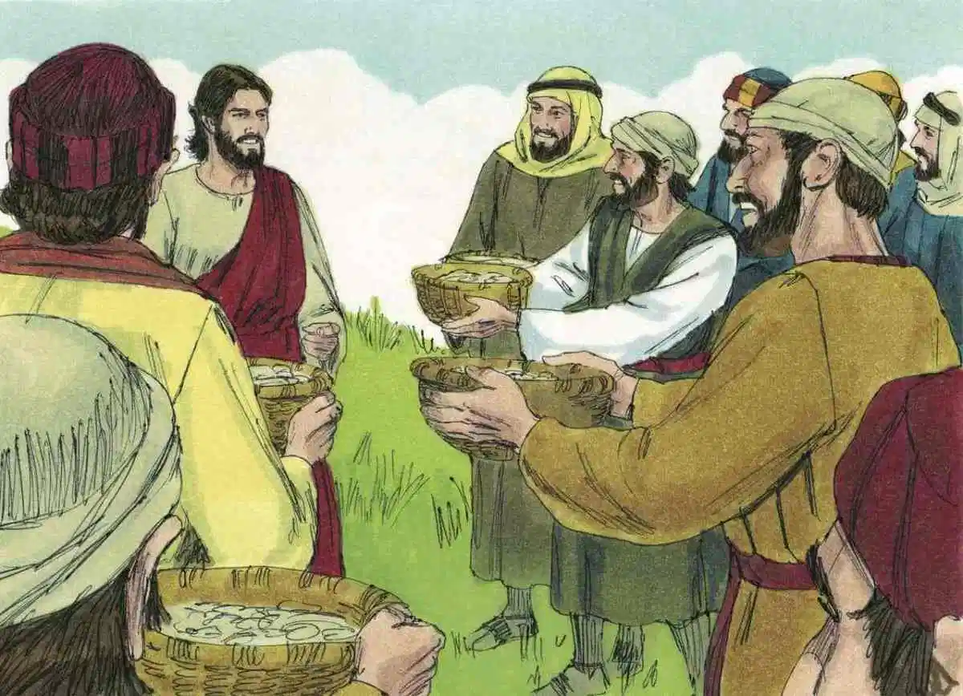
Then Jesus said, “Gather up the pieces of food that are left, so that nothing may be wasted.” Twelve baskets of food were left.

Slide 9
Questions to think about?
What did Jesus do right before the miracle of the multiplication of the bread and fish?
Who else was generous in this event besides Jesus?
After everyone had been fed, Jesus asked the Apostles to collect the leftover bread and fish. They collected 12 baskets! What does this tell you about the LEVEL of generosity of God?
How is being STINGY opposite of GENEROUS?
What did you think Jesus meant “so that nothing is wasted”?

