Slide 1
Story About Gratitude
#Hyperdoc Template created by Kelly Hilton. Adapted by Sr. Ignacia Carrillo, FMA
Notes:
.)

Slide 2
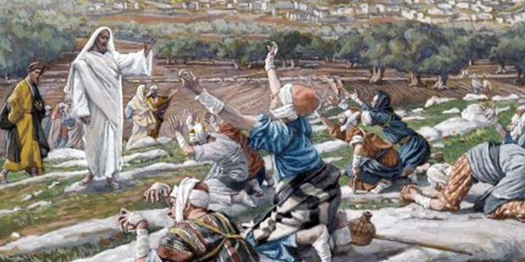
“The Ten Lepers” Luke 17:11-19
As Jesus was entering a certain village on His way to Jerusalem, ten lepers met him. They were not allowed to live among the other people because of their disease, so they stood far away and cried out with a loud voice, “Jesus, master, have pity on us.”

Slide 3
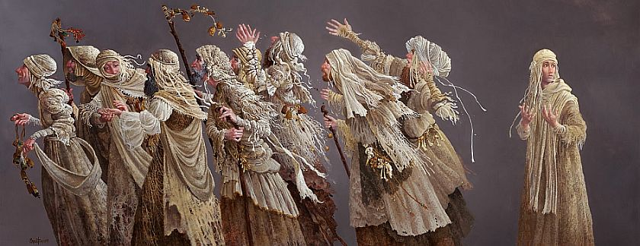
And when Jesus saw them He had pity on them and told them to come closer. He then said to them, “Go, show yourselves to the priests that they may declare that you are clean again and cured of your disease.” On their way to the temple, they were cured. They were so happy that they did not even think of coming back to Jesus to thank Him.

Slide 4
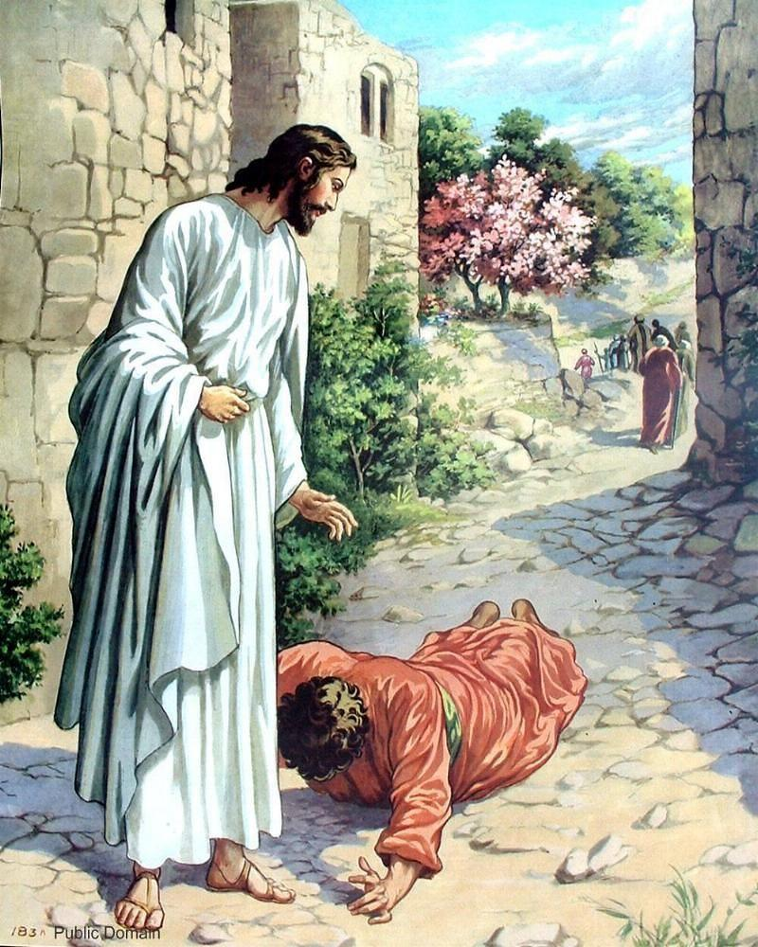
Only one of them, seeing that he was made clean, returned and bowed low before Jesus and thanked Him with all his heart. And he was not even a Jew, but a Samaritan.

Slide 5
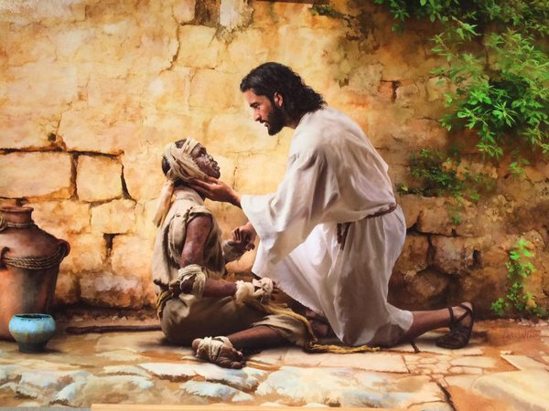
Then Jesus asked, “Were not ten made clean? But where are the other nine? “Did no one come back and thank God except this foreigner?” And Jesus said to him, “Arise, go your way, for your faith has saved you.”

Slide 6
What do we learn about gratitude in this scripture passage?
Gratitude requires not just feeling thankful but showing it in our actions too!
Ten were healed but only one came back
He was the outsider-the Samaritan

Slide 7
Think About it
Do you always say thank you?
What are you most grateful for in your life?
Have you ever done something for someone and not been thanked for it? How did you feel?
Notes:
Let’s say this prayer together!

Slide 8
Thank you God
Thank you God for this new day.
Thank you for your many blessings. Help me never to forget to be grateful for all that I have and help me to share with those who have less.
Amen.
Notes:
Let’s say this prayer together!

