Slide 1
The Paralytic Man
Mark 2:1-12
#Hyperdoc Template created by Kelly Hilton. Adapted by Sr. Ignacia Carrillo, FMA

Slide 2
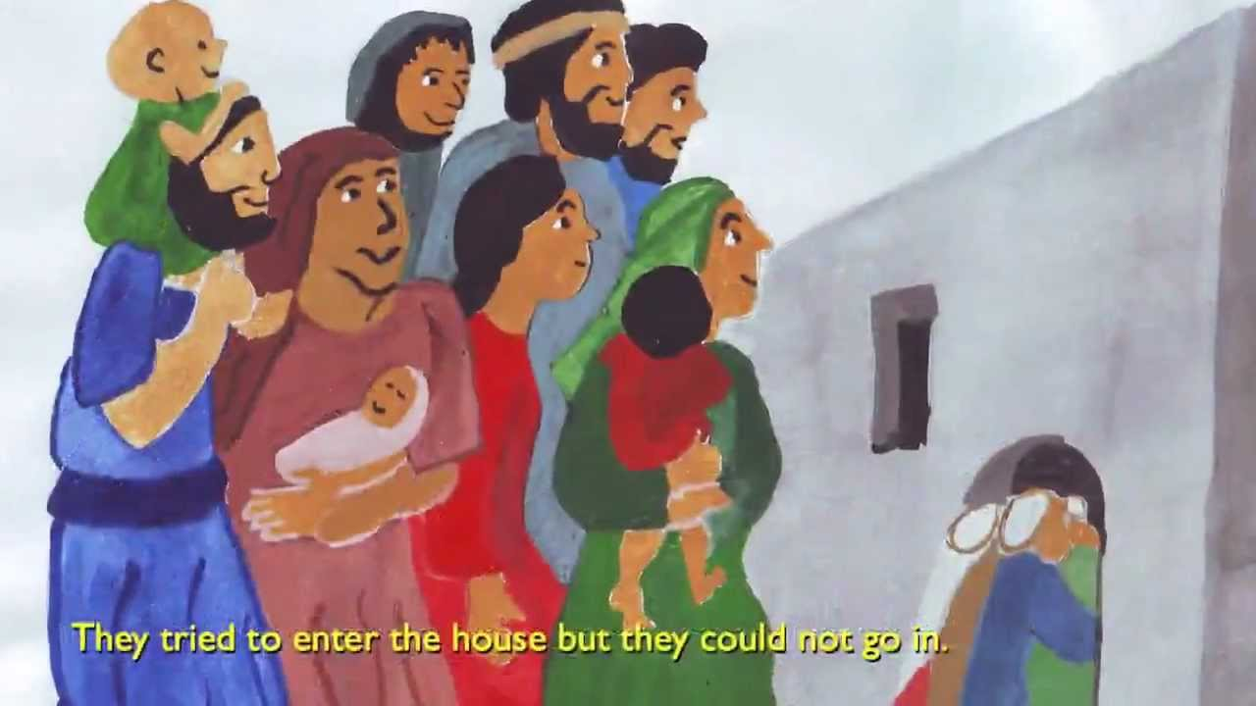
When Jesus returned to Capernaum after some days, it became known that he was home. Many gathered together so that there was no longer room for them, not even around the door, and he preached the Word to them.

Slide 3
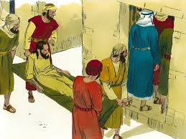
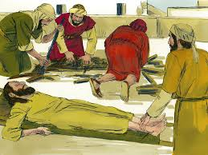
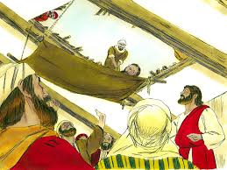
They came bringing him a paralytic carried by four men. Unable to get near Jesus because of the crowd, they opened up the roof above him. After they had broken through, they let down the mat on which the paralytic was lying.

Slide 4
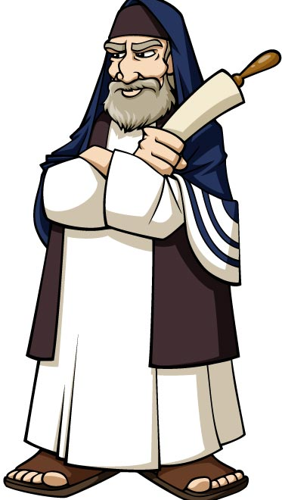
When Jesus saw their faith, he said to the paralytic, “Child, your sins are forgiven.” Now some of the scribes were sitting there asking themselves, “Why does this man speak that way? He is blaspheming. Who but God alone can forgive sins?”
8

Slide 5
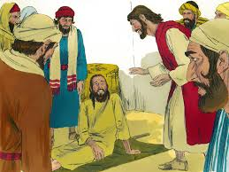
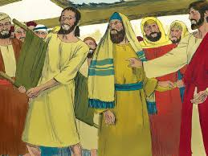
“Which is easier, to say to the paralytic, Your sins are forgiven, or to say, Rise, pick up your mat and walk?
But that you may know that the Son of Man has authority to forgive sins on earth” He said to the paralytic, “I say to you, rise, pick up your mat, and go home.”

Slide 6
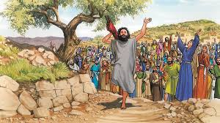
He rose, picked up his mat at once, and went away in the sight of everyone. They were all astounded and glorified God saying, “We have never seen anything like this.”

Slide 7
How did the four friends use their creativity to help the paralytic?
What do you think would have happened if they had not been creative in trying to help their friend?
When we have faith, we act. These friends had faith in the healing power of Jesus and they acted! They dug a hole in the roof, they lowered their friend so that Jesus could heal him! How do you know you have faith in Jesus? Or how do you “get” faith?
What does this piece of advice mean: Be friendly to everyone but choose your friends wisely….
..

