Slide 1
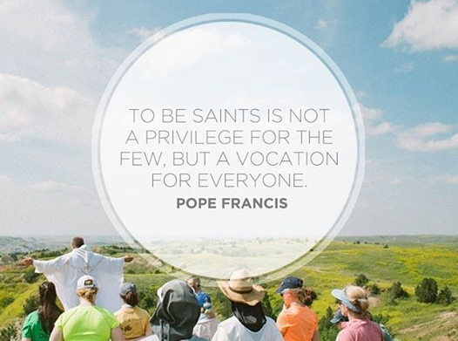
Universal Call to Holiness

Slide 2
Matthew 5:43-38
“You have heard that it was said, ‘You shall love your neighbor and hate your enemy.’ But I say to you, love your enemies, and pray for those who persecute you, that you may be children of your heavenly Father, for he makes his sun rise on the bad and the good, and causes rain to fall on the just and the unjust. For if you love those who love you, what recompense will you have? Do not the tax collectors do the same? And if you greet your brothers only, what is unusual about that? Do not the pagans do the same? So be perfect, just as your heavenly Father is perfect.”

Slide 3
Jesus’ disciples, as children of God, must imitate the example of their Father, who grants his gifts of sun and rain to both the good and the bad.
Jesus’ disciples must not be content with merely usual standards of conduct.
Perfect: in the gospels this word occurs only in Matthew, here and in Mt 19:21 (“If you wish to be perfect, go, sell what you have and give to [the] poor, and you will have treasure in heaven. Then come, follow me.”) The Lucan parallel (Lk 6:36) demands that the disciples be merciful.

Slide 4
Universal Call to Holiness
The central document of Vatican II was Lumen Gentium. The heart of this document its teaching in chapter five that the call to holiness is not limited to any one state in life, but is indeed universal, embracing all baptized Christians. It consists in the perfection love (charity).

Slide 5
Nearly 400 years before Vatican II,
St. Francis de Sales (1567-1622), articulated the universal call to holiness in a book that is still a spiritual classic today: Introduction to the Devout Life. All people, he said, are called to holiness, and can (must) carry out lives of devotion according to each person's individual position and state in life (married, widowed, laborer, businessperson, etc.).

Slide 6
St. Francis de Sales was born to a noble family near Geneva, Switzerland in 1567. He desired to serve God in the priesthood from an early age, but kept it to himself because his father wanted him to be a lawyer and politician. After receiving a doctorate in law at the age of 24, and after much discussion and disagreement with his father, Francis entered the seminary and was ordained to the priesthood in 1593. Francis was zealous for the salvation of souls, especially the fallen away Catholics, and was later made bishop of Geneva at the age of 35.

Slide 7
Though he was naturally hot tempered, he learned to control it and was known for his gentle, loving spirit and approachable ways. He was a gifted spiritual director, writer, catechist and preacher. Francis de Sales was one of the first to articulate a lay spirituality in the Church when describing the “Universal Call to Holiness”. Together with St. Jane de Chantal, he founded and directed the Order of the Visitation Sisters. The Salesians of Don Bosco, the Oblates of Saint Francis de Sales, and the Missionaries of Saint Francis de Sales are named in his honor.

Slide 8
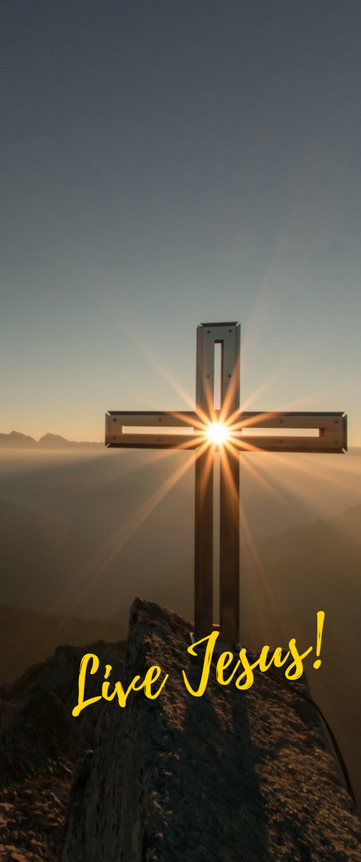
St. Francis de Sales stated “I have wished above all else to engrave and inscribe on your heart this holy and sacred motto, “Live, Jesus!”…As our beloved Jesus lives in your heart, so too he will soon live in all your conduct and he will be revealed by your eyes, your mouth, your hands, yes even the hair on your head. With St. Paul you can say these holy words, “It is no longer I that live, but Christ lives in me”. (Intro. to the Devout Life, Part III, ch. 23)

Slide 9
How to live in holiness…do the right thing, at the right time, with the right attitude, for the love of God and neighbor
Christian devotion in daily life
Duty done well
Relationship with others
Loving God and neighbor

Slide 10
6 Principles of the Call to Holiness
The human person of oriented to God
Human nature is fallen, but not corrupt/ redeemed and graced
God reaches out and freely invites every person to union with Him.
We encounter God in our humanity (sorrow, joys and ordinary moments in life bring us closer to God).

Slide 11
2) God’s goodness permeates
Balanced life
Response to God’s will (live in joy, not morning)
Perfection of Christian life consists in conforming our will with that of our good Lord’s

Slide 12
3) All are called to find God
God’s good pleasure: to give life abundantly
Bloom where you are planted
Jesus lives in each Christian heart open to Him.
Thinking of God: to discover God in our neighbor, it makes Jesus alive for us.

Slide 13
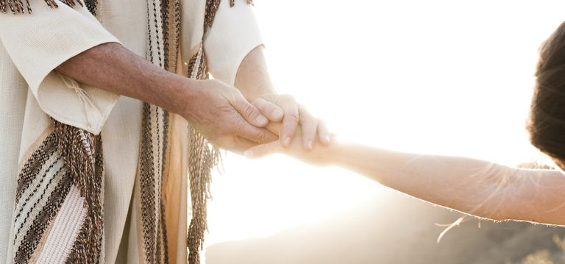
4) God in the midst of our lives
Human experience: God does not force
Freedom is central to God’s plan: fully human and free to love, choose & grow.
God’s love is free and looks for a free response: love with a pure heart (indifference & detached)
“Do all things with love and nothing by constraint”
-St. John Bosco

Slide 14
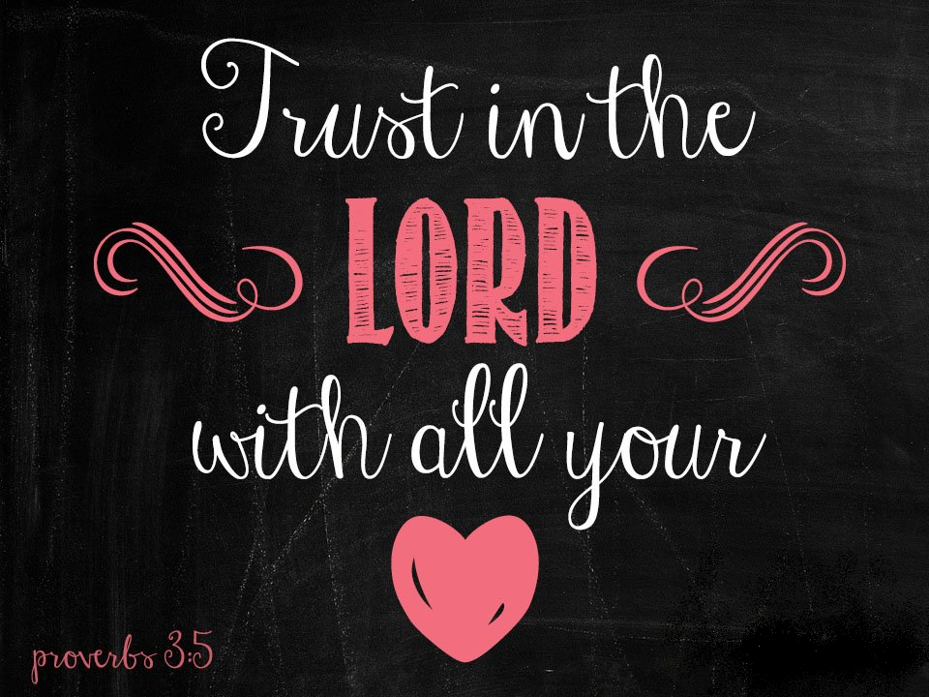
5) Christian life is a journey of the heart
The heart of Jesus is the meeting place of devout souls.
God is hidden in the midst of everyone's heart
It is love that attracts the young to do good.
Love what they love and they will love who (God) you love!

Slide 15
6) All little things in life have value
Little virtues: hidden process of spiritual growth
Meet Jesus at the cross (recognize His face in all discouragement, joys, and ordinary moments.)
Self mortification/ fasting
Unseen, but heroic

Slide 16
On April 9, 2018, Pope Francis released his latest Apostolic Exhortation: Gaudete et Exsultate (Rejoice and Be Glad): On the Call to Holiness in Today’s World. This is the third Apostolic Exhortation of his papacy, following Evangelii Gaudium, the Apostolic Exhortation on the Proclamation of the Gospel in Today’s World and Amoris Laetitia, a post-synodal Apostolic Exhortation on Love in the Family. What was his goal? “To re-propose the call to holiness in a practical way for our own time, with all its risks, challenges and opportunities" (GE 2).

Slide 17
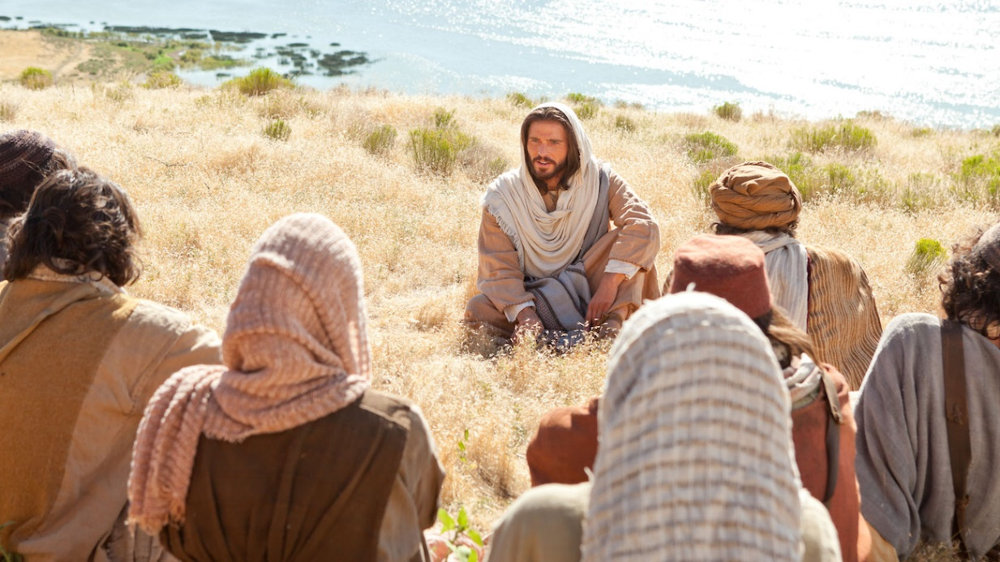
Pope Francis invites us simply and practically to open ourselves to the specific and unique mission God has created us for. In this, he says, lies true joy and freedom. Our Holy Father takes us back to the Source of Holiness, Jesus Christ, and encourages us to look to the Beatitudes as guides for holiness.

Slide 18
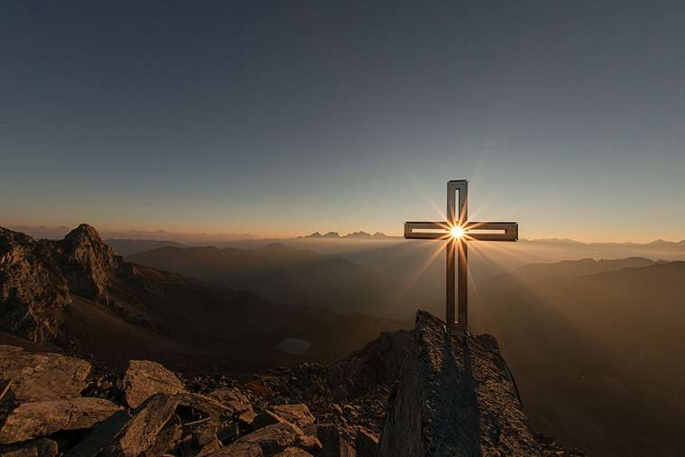
Live Jesus!

