Slide 1
Courage
#Hyperdoc Template created by Kelly Hilton. Adapted by Sr. Ignacia Carrillo, FMA

Slide 3
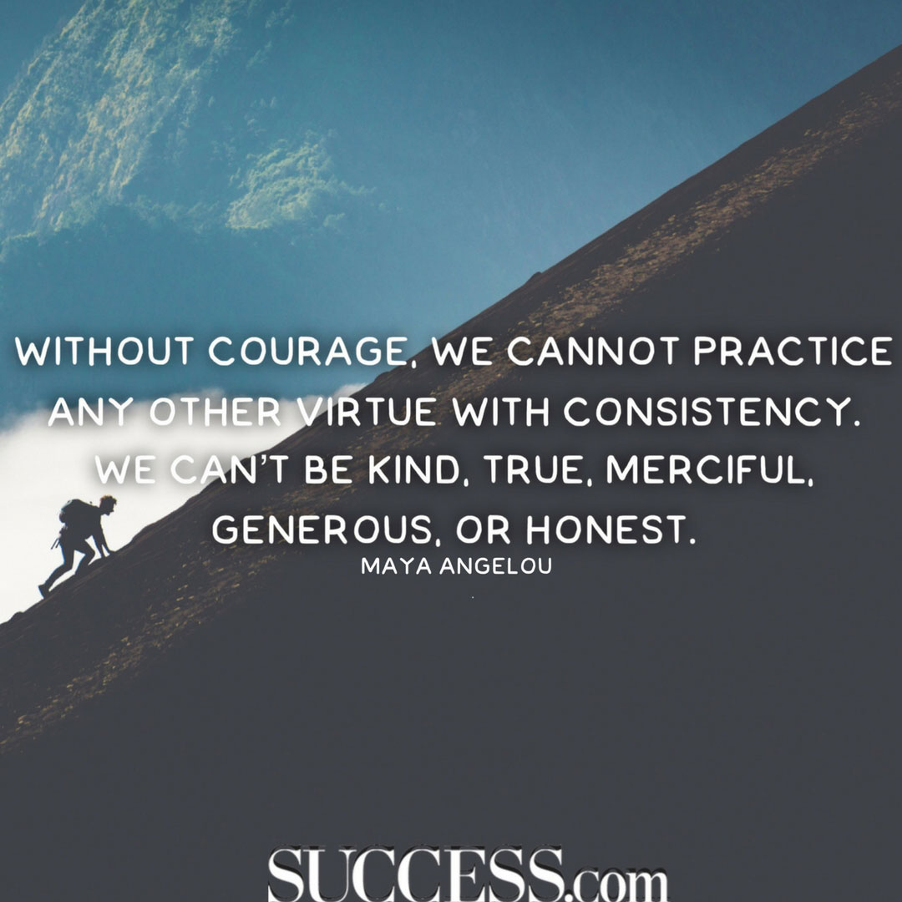

Slide 4
What is a Virtue?
A virtue is a habitual and firm disposition to do the good. It means to be our best self and choosing the GOOD in every circumstance. Today we are going to learn about the virtue of
Courage!

Slide 5
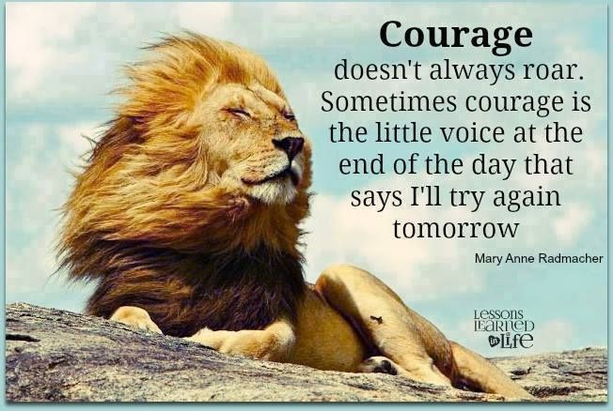
Courage is choosing to do the right thing, especially when it is difficult.

Slide 6
Examples of Courage as a virtue:
Talk to a classmate you don’t like.
Stand up for what is right when others don’t agree.
Telling a friend he/she is doing something that is not right even though they might get upset with you.
Notes:
What might be other times that you might need courage?
-trying new things
-raising your hand in the classroom even if you are not sure of the answer
-trying a new vegetable or food; just because you have never tried it and you think you might not like it
-keep practicing something you might not be that good at-instrument;you mulitplication tables; tieing your shoes; learnig a new sport..it starts with the little things; it starts with the right attitude

Slide 7
Who do you know that practices COURAGE as a virtue?
Notes:
Here you would invite the children to share. Be ready to accept all answers. You might get batman, superman, or grandma, mom, dad, etc.
After the children share and have given examples then you continue. Now thank them for sharing and say: now we are going to share about some people in history who lived a long time ago and some who are alive today who showed courage in their lives.

Slide 8
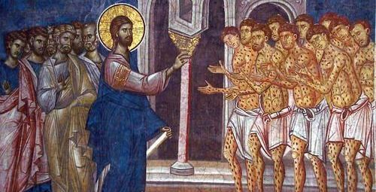
Jesus showed courage
How did he show courage?
Notes:
Jesus showed courage in many instances. He was not afraid to help the people who were outcasts, the people no one liked or wanted to help. He did not worry about what people would think. He was brave and wanted to help anyone who needed help.

Slide 9
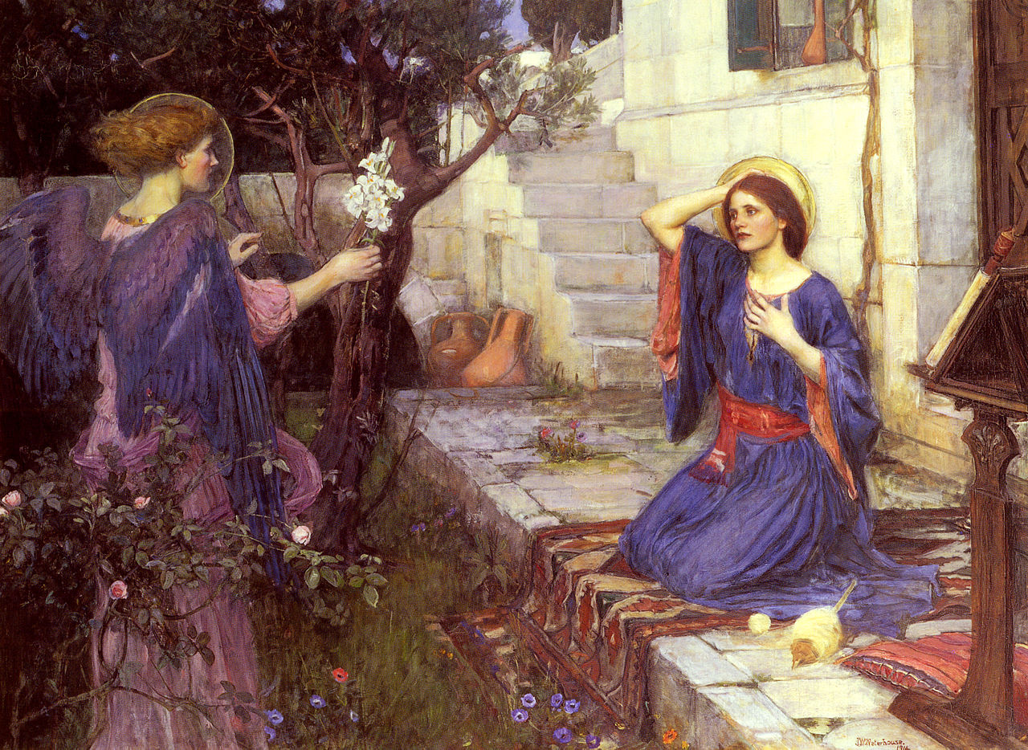
Mary was brave.
Notes:
Mary was a simple girl. She loved God and did her best to obey his laws. One day, an angel appeared to her and told her she had been chosen to be the mother of the son of God. She was just a teenager! She could have said NO, I won’t do this. I am afraid.

Slide 10
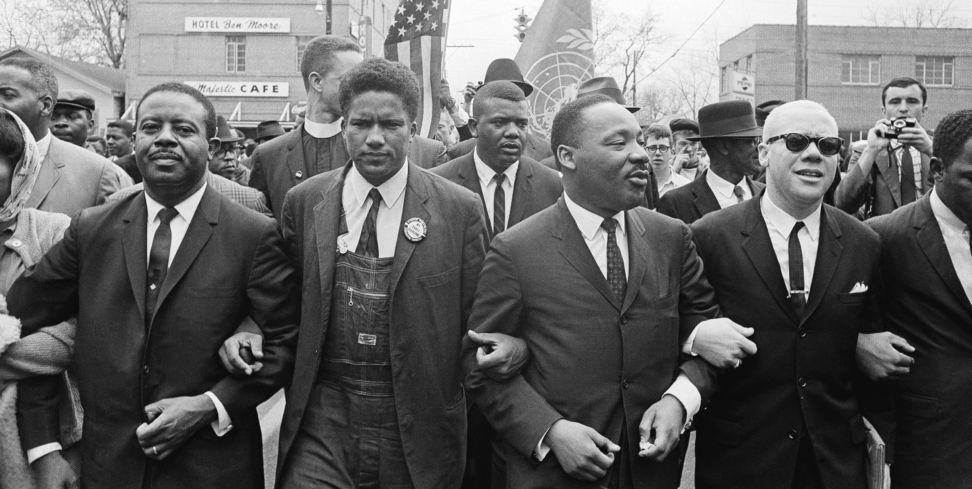
Martin Luther King Jr. stood up for others’ rights.
Notes:
Dr. Martin Luther King Jr. lived in a time when things were not fair for many African Americans. The laws were unjust and he fought to change the laws. He believed every person had basic rights that should be respected. He was killed for his beliefs in justice and peace.

Slide 11
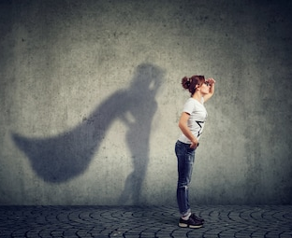
Courage
Be strong and let your heart take courage
Stand firm and by your heart be led
Be brave when you feel afraid
Then let go of fear
And with courage move ahead
Courage is a quality of the heart
The Spirit of God within me
Courage is bravery in
Face of my fears
With wisdom and humility
Be strong when life overwhelms you
Find courage to try new things
Don’t give up when something
Feels hard to do
With courage we can do great things
By Jennifer Russell

